Slide 1

Nurses’ role in the implementation of evidence-based practice in hospitals
Ashlee Oikarainen
Researcher
RN, MHSc, PhD-candidate

Slide 2



Our aim is to develop and establish evidence-based nursing in Finnish health care so that nursing interventions are effective, appropriate, feasible and meaningful

Slide 3

Evidence-based decision-making considers…
Best available evidence
Clinical evidence and expertise
Patient values and preferences
Relevant contextual knowledge
Aim is to deliver appropriate care in an efficient manner to the patient
Source: Sakett et al., 1996; DiCenso et al., 1998; McCormack et al., 2002; Rycroft-Malone, 2008; Jylhä et al. 2017 (picture from Pixabay)

Slide 4
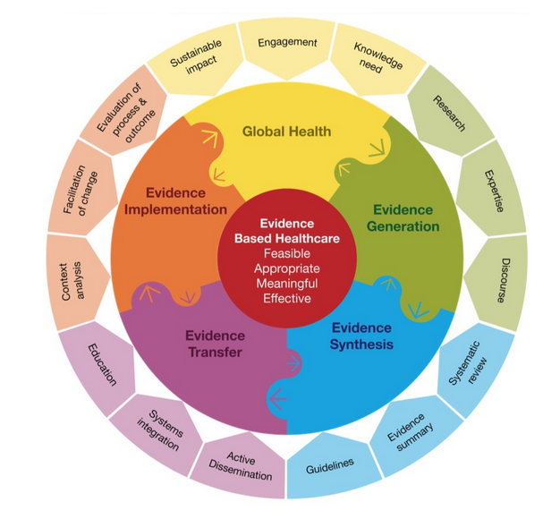
JBI Model of Evidence Based Healthcare
Overarching principles
Culture-Capacity-Communication-Collaboration
Source: Jordan et al. 2016, p. 4

Slide 5
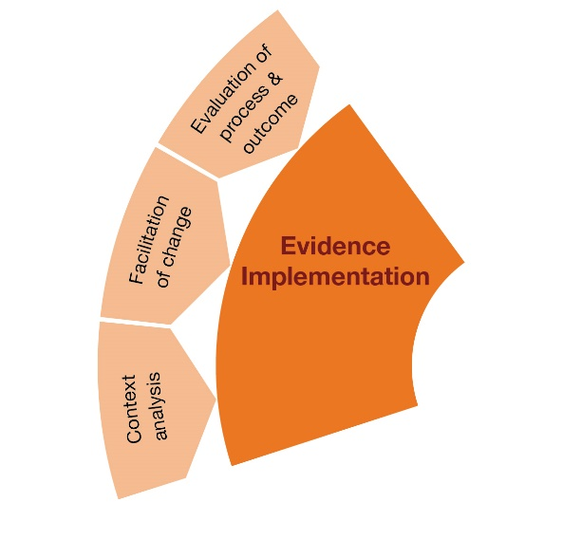
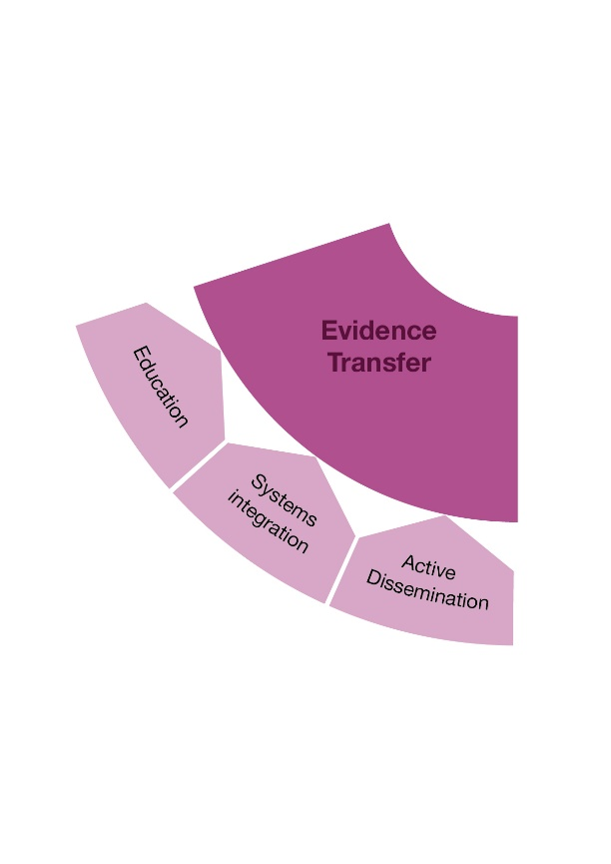
The transfer of synthesized evidence supports implementation of evidence into practice
The components of implementation include..
  An analysis of the context or situation
  Facilitation of practice change
  Evaluation of process and outcome
Source: Jordan et al. 2016, p. 8-10

Slide 6
Transfer of evidence
Time
Awareness
Agreement
Adoption
Adherence
Diffusion
Dissemination
Implementation
© Nursing Research Foundation
Based on Pathman et al. 1996 awareness-to-adherence model

Slide 7
JBI Model of Evidence Based Healthcare
Implementation plan
Overarching principles
Culture-Capacity-Communication-Collaboration
Source: Jordan et al. 2016, p. 4, 11

Slide 8

Nurses’ role in the implementation of evidence-based practice in hospitals
Pixabay

Slide 9

What does the implementation of EBP mean to me as a nurse?
I feel confident during emergency situations.
After doing a patient assessment, I recognized that my patient was in need of resuscitation.
I quickly began CPR using an evidence-based, effective chest compression technique.
At my workplace, there are clear CPR guidelines that are updated as needed and that are easy for staff to access.
We are provided annual CPR training where we are given the most up-to-date information on CPR.
Pixabay

Slide 10

What does the implementation of EBP mean to me as a nurse?
I have the necessary hand hygiene competence to keep myself and my patients healthy.
I know that good hand hygiene is critical to infection prevention in hospitals.
There is robust evidence that supports good hand hygiene as an effective method in lowering the cost of care and ensuring good patient outcomes.
At my workplace, we have use an operational model to engage employees in effective hand hygiene practices.
My employer offers nurses education, observes nurses’ hand hygiene practices frequently, and provides feedback on a regular basis at team meetings.
Pixabay

Slide 11
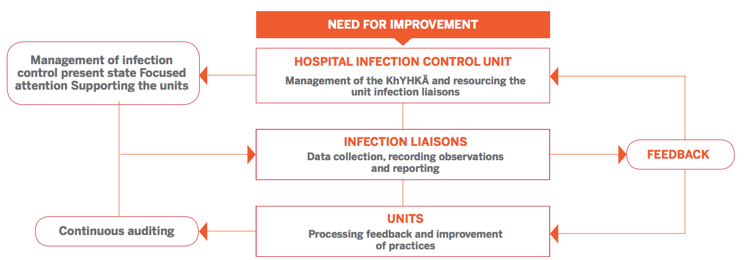
Consistent operational model for monitoring hand hygiene practices
Copyright Ⓒ Oulu University Hospital & Nursing Research Foundation
Available: http://www.hotus.fi/system/files/Operational_model_KhYHK%C3%84.pdf

Slide 12
National, regional and local support structures needed to…
Produce, disseminate, and implement knowledge
Develop consistent practices
Ensure the continued development of nurses’ competence
Source: Holopainen et al., 2010; Jylhä et al., 2017

Slide 13
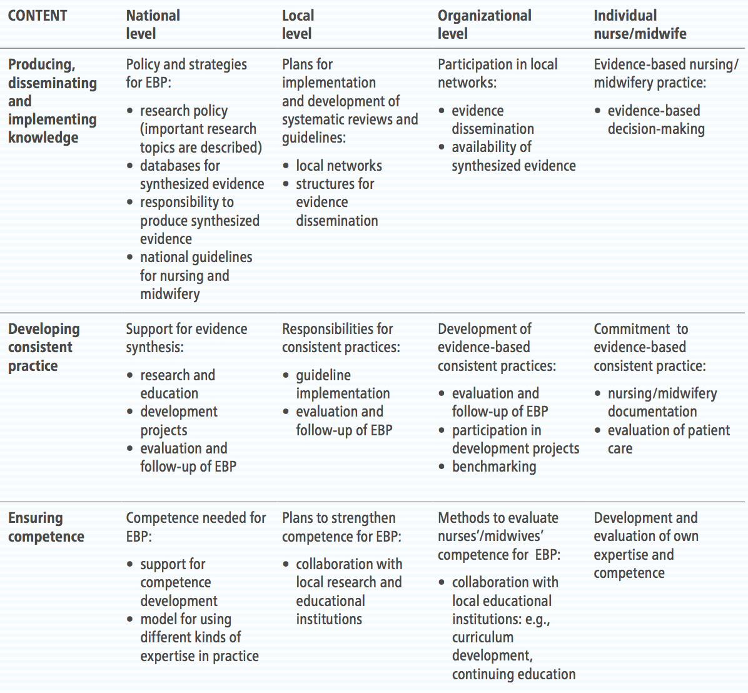
Responsibilities at different levels of healthcare systems
for developing evidence-based practices
Source: Holopainen et al., 2010
Figure copied from: Jylhä et al., 2017

Slide 14
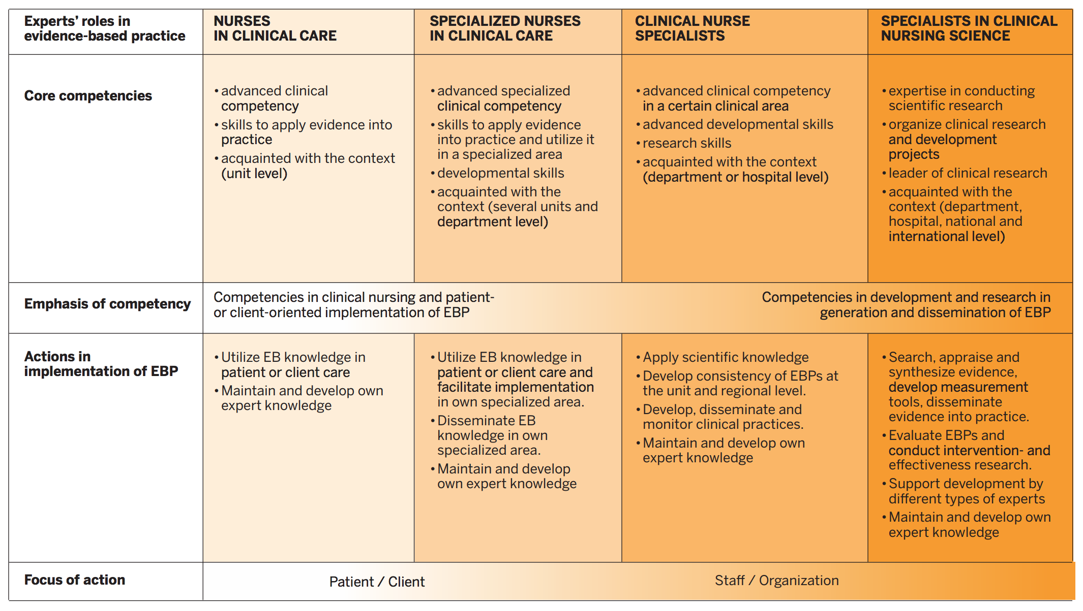
Finnish Action Model of Expertise in Evidence-Based Health Care
Reference: http://www.hotus.fi/hotus-en/expertise-evidence-based-health-care
Modified from: Ministry of Social Affairs and Health, 2009

Slide 15

Research Director
Dr. Arja Holopainen
arja.holopainen@hotus.fi
Follow us on Twitter @HotusFI

Slide 16
References
DiCenso, A., Cullum, N., Ciliska, D., 1998. Implementing evidence-based nursing: some misconceptions. Evid Based Nurs. 1, 38–39.
Holopainen, A., Korhonen, T., Miettinen, M., Pelkonen, M., Perälä, M.-L., 2010. Hoitotyön käytännöt yhtenäisiksi - toimintamalli näyttöön perustuvien käytäntöjen kehittämiseksi. [Consistent nursing practices - a model for developing evidence-based practices] Premissi (1), 38-45
Jordan, Z., Lockwood, C., Aromataris, E., Munn, Z., 2016. The updated JBI model for evidence-based healthcare. The Joanna Briggs Institute. http://joannabriggs.org/assets/docs/approach/The_JBI_Model_of_Evidence_-_Healthcare-A_Model_Reconsidered.pdf
Jylhä, V., Oikarainen, A., Perälä, M.L., Holopainen, A., 2017. Facilitating evidence-based practice in nursing and midwifery in the WHO European Region. World Health Organization.
McCormack, B., Kitson, A., Harvey, G., Rycroft-Malone, J., Titchen, A., Seers., 2002. Getting evidence into practice: the meaning of `context`. J Adv Nurs. 38, 94–104.
Pathman, D.E., Konrad, T.R., Freed, G.L., Freeman, V.A., Koch, G.G., 1996. The awareness-to-adherence model of the steps to clinical guideline compliance: the case of pediatric vaccine recommendations. Med Care. 34, 873–889.
Rycroft-Malone, J., 2008. Evidence-informed practice: from individual to context. J Nurs Manag. 16, 404-408.
Sackett, D.L., Rosenburg, W.M.C., Muir Gray, J.A., Haynes, R.B., Richardson, W.S., 1996. Evidence-based Medicine, what it is and what it isn’t. Br Med J. 312, 71–72.

Slide 17

Available online: link

